Slide 1
Render
Lecturer: Ngo Huy Bien
Software Engineering Department
Faculty of Information Technology
VNUHCM - University of Science
Ho Chi Minh City, Vietnam
nhbien@fit.hcmus.edu.vn

Slide 2

Objectives
To deploy a Node.js application to Render.

Slide 3

Contents

Slide 4

References

Slide 5
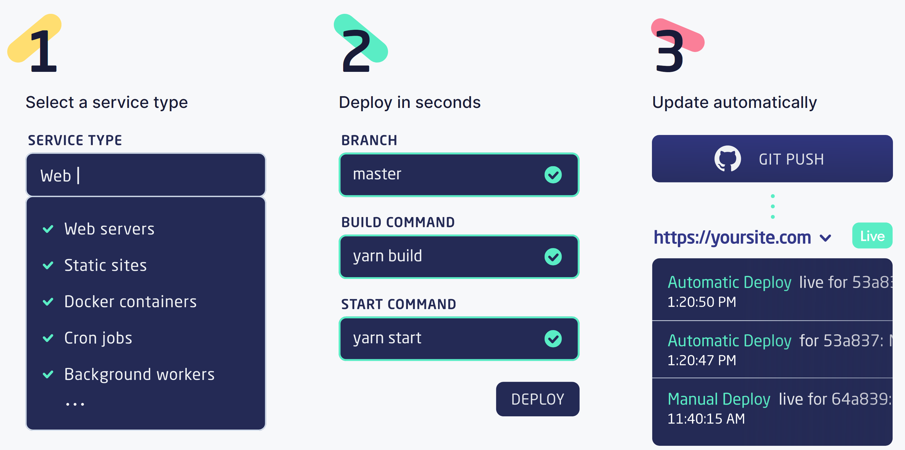
Render
https://render.com/
Render is a unified cloud to build and run all your apps and websites with free TLS certificates, a global CDN, DDoS protection, private networks, and auto deploys from Git.

Slide 6
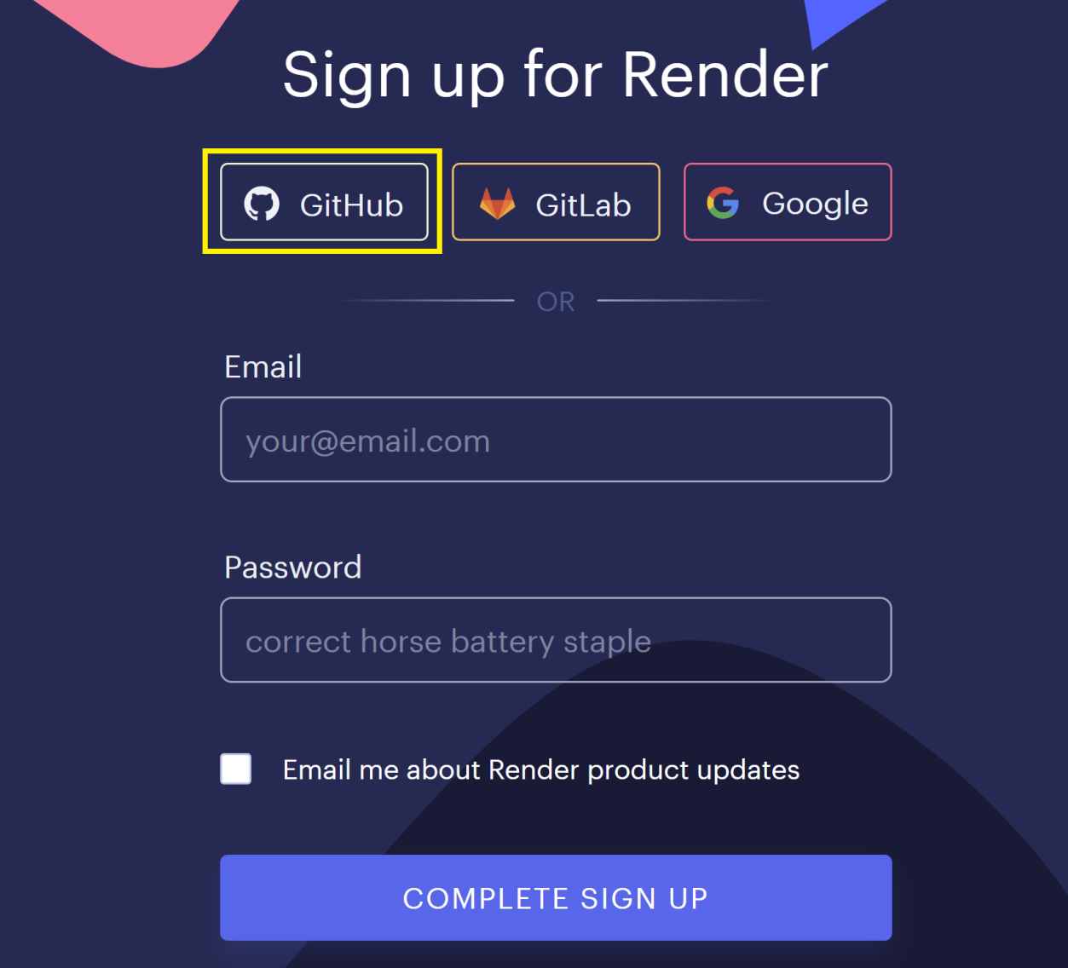
1. Sign up for Render using GitHub
https://dashboard.render.com/register

Slide 7
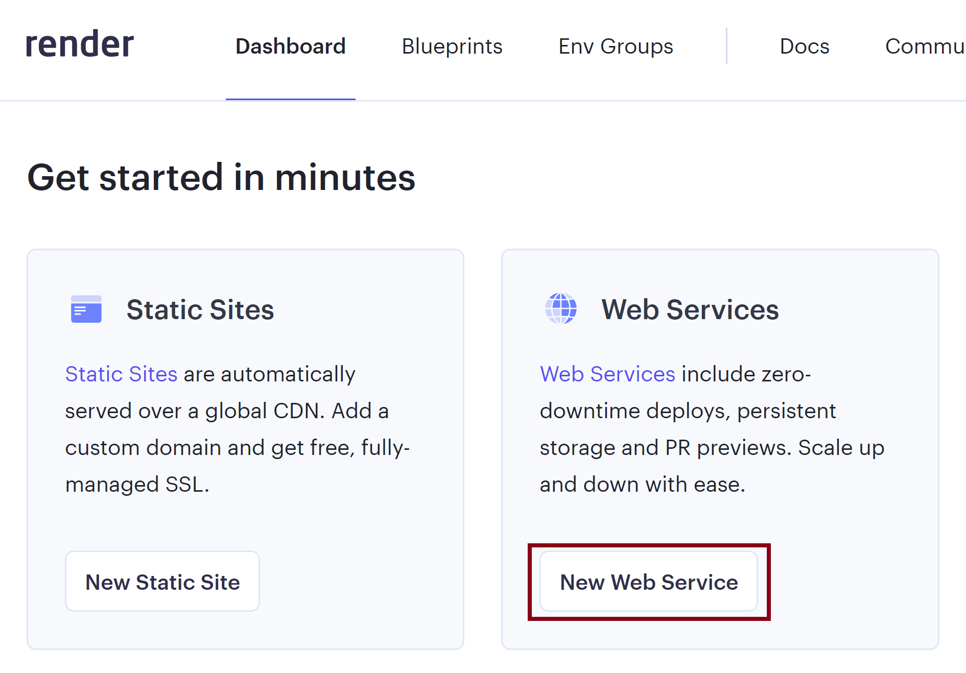
2. Create New Web Service
https://dashboard.render.com/

Slide 8
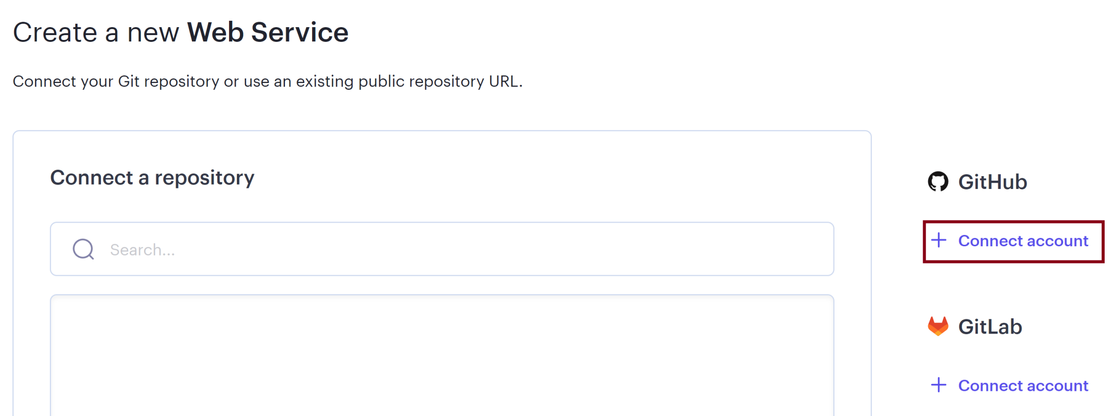
3. Connect GitHub Account

Slide 9
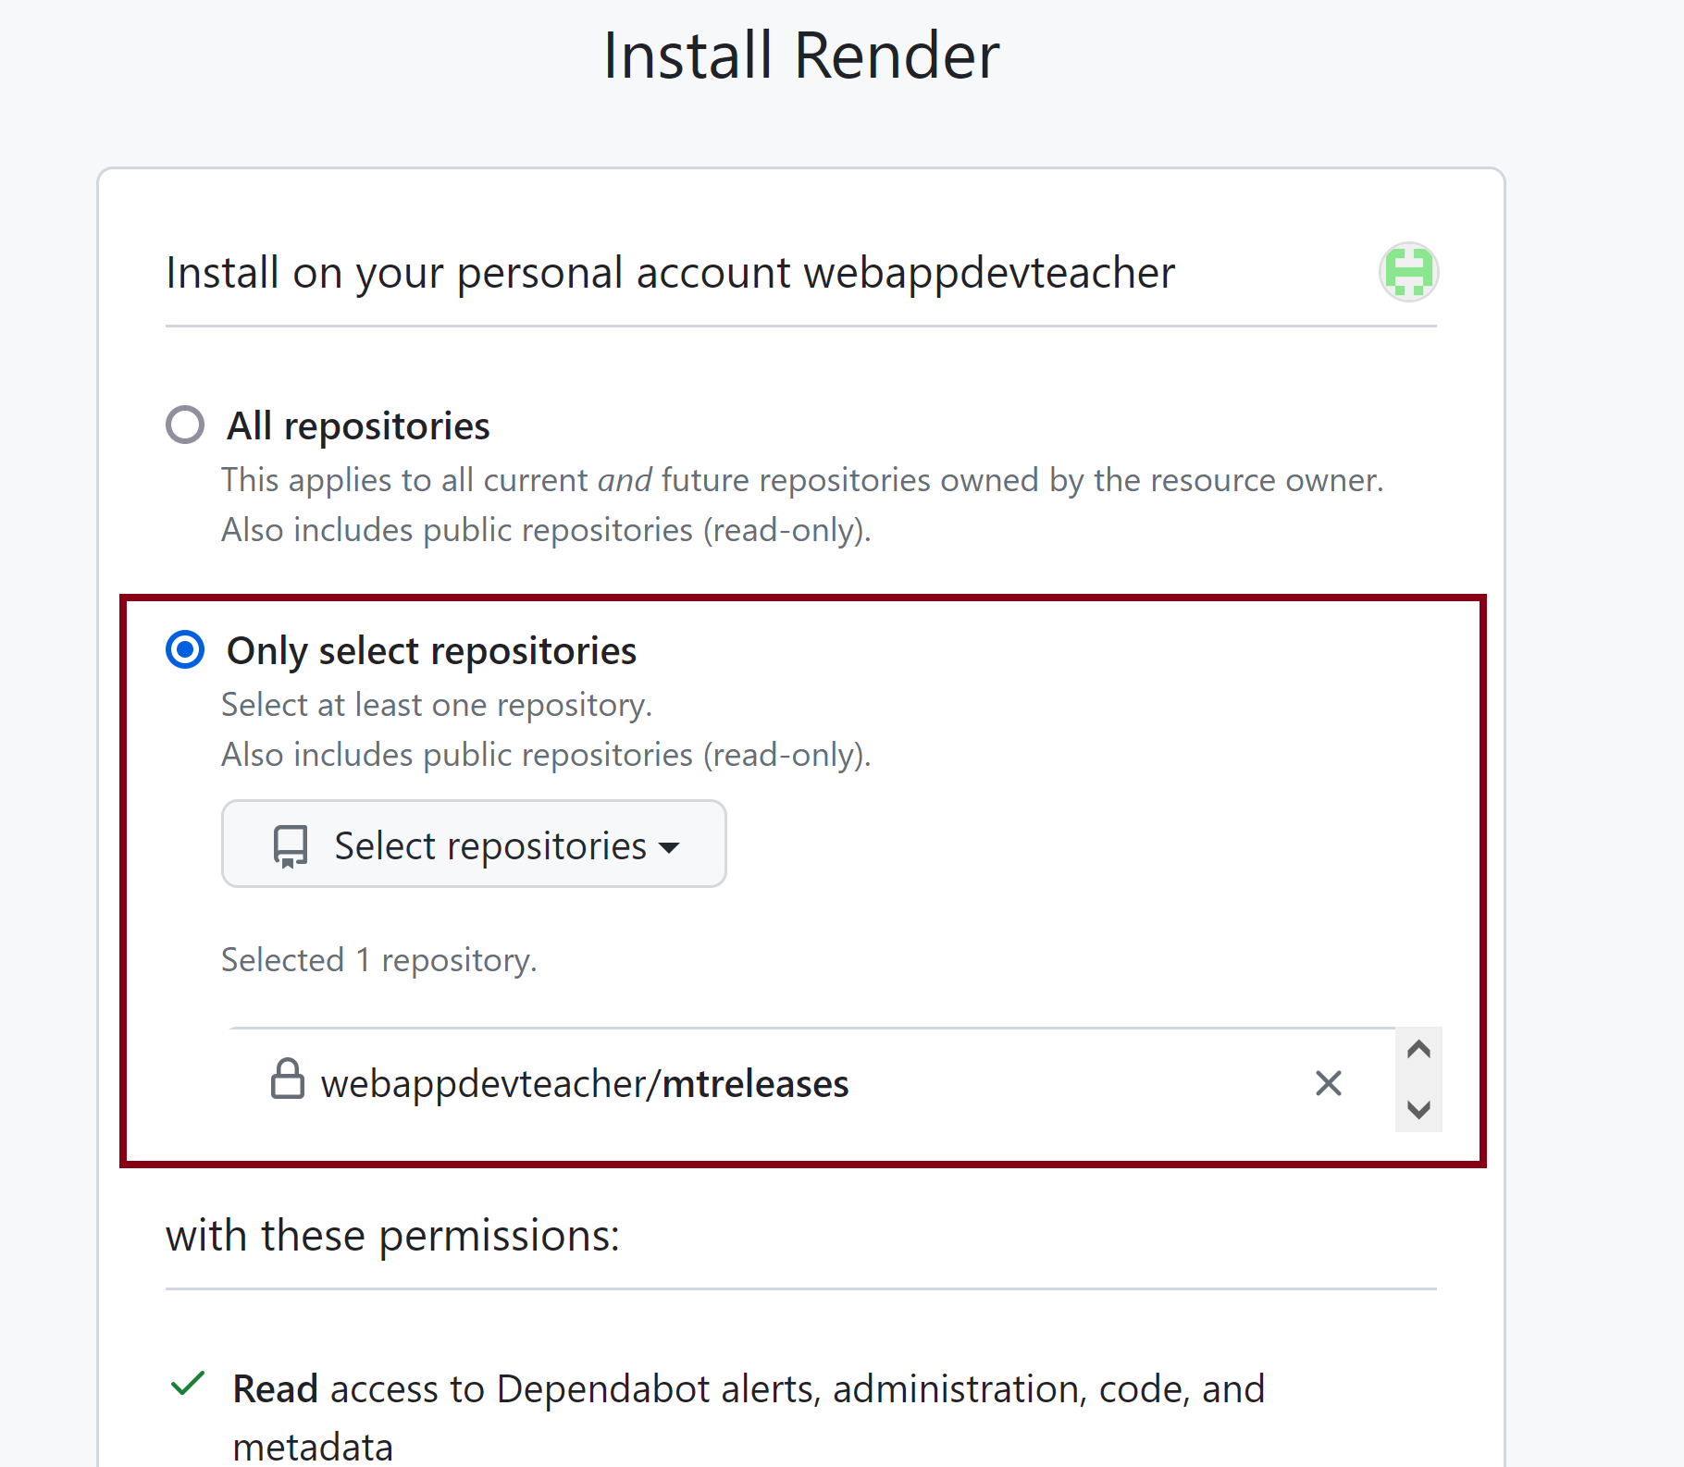
4. Select Repositories

Slide 10
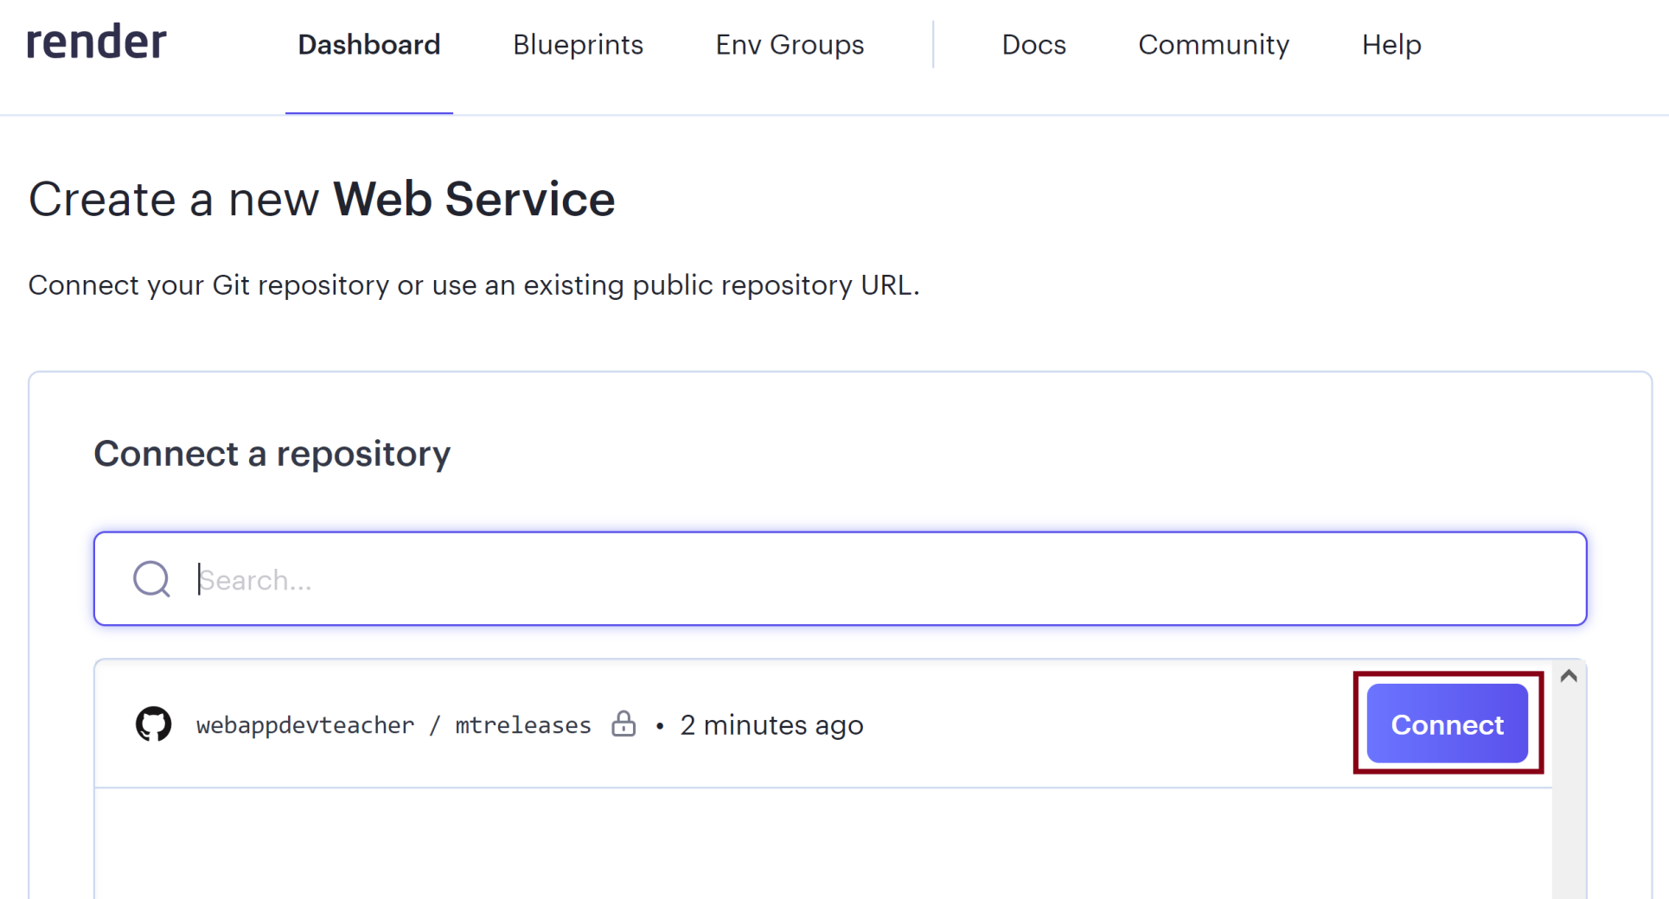
5. Connect a Repository

Slide 11
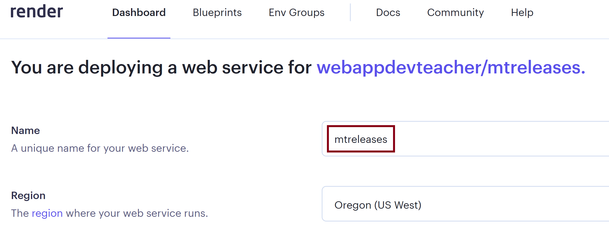
6. Enter a Name

Slide 12
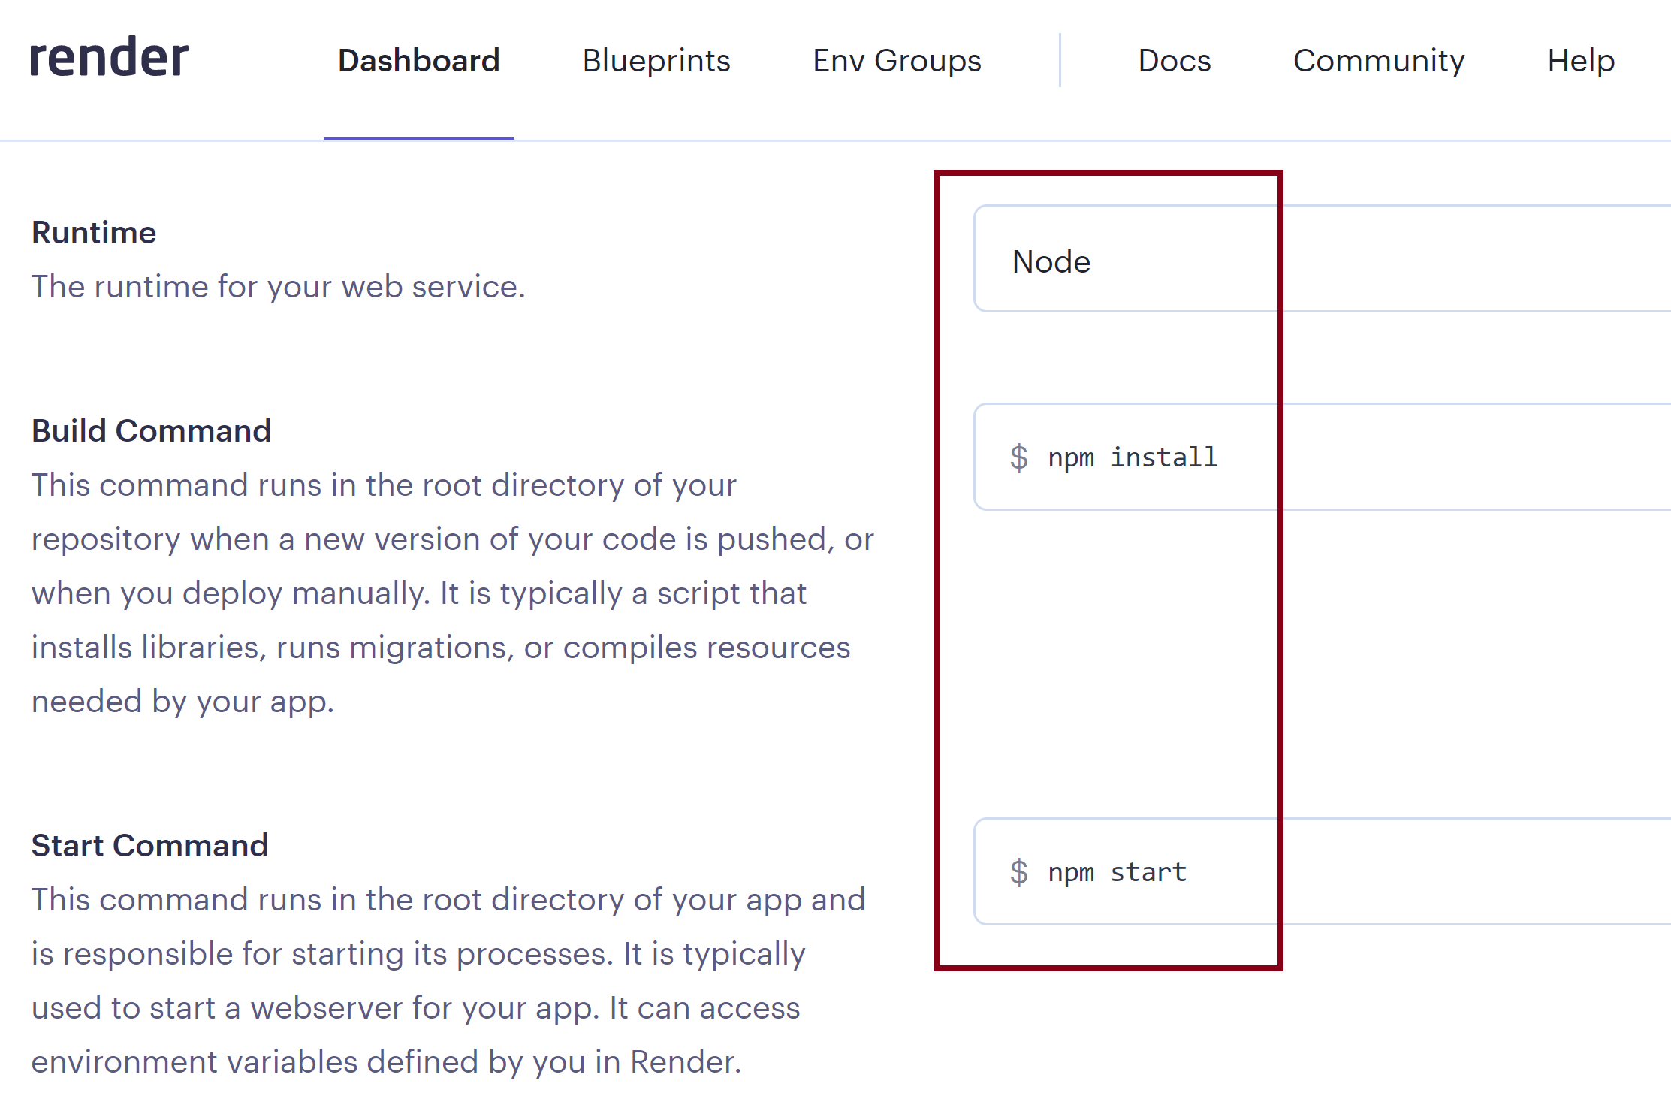
7. Select Runtime

Slide 13
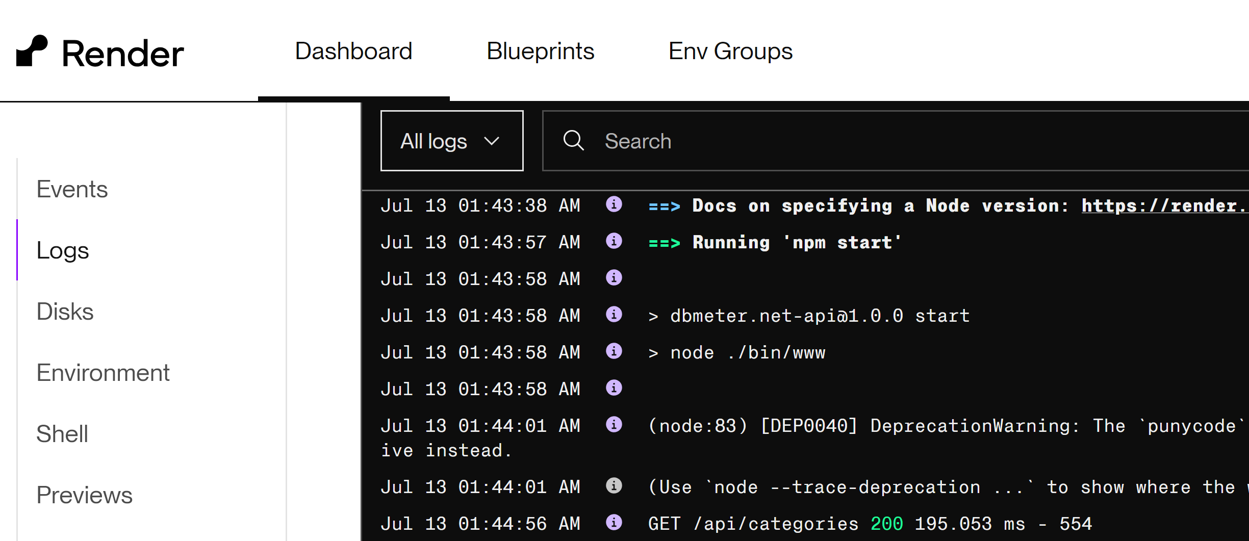
8. Review Logs

Slide 14
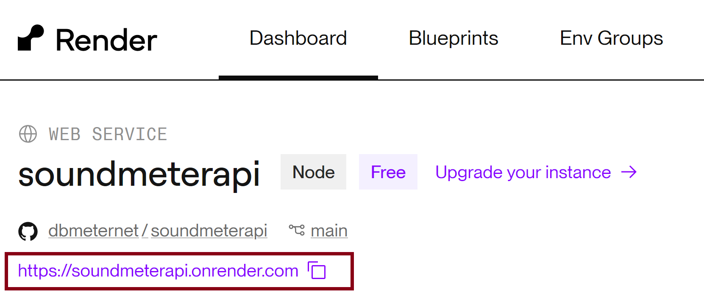
9. Get App URL

Slide 15


Slide 16
1. Create CNAME Records
https://docs.render.com/custom-domains#adding-a-custom-domain
soundmeterapi -> soundmeterapi.onrender.com
_acme-challenge -> soundmeterapi.verify.renderdns.com

Slide 17
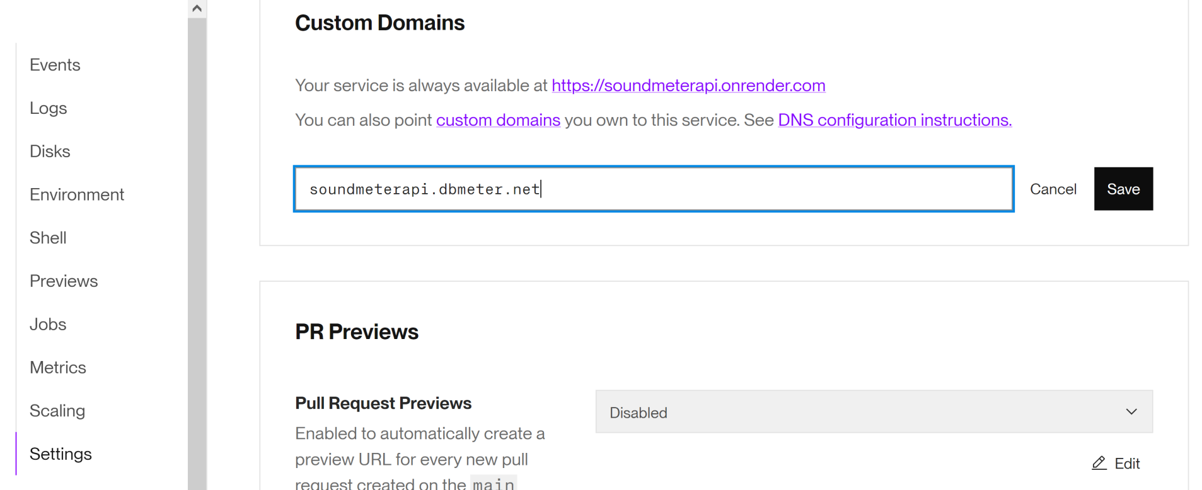
2. Add Custom Domain

Slide 18
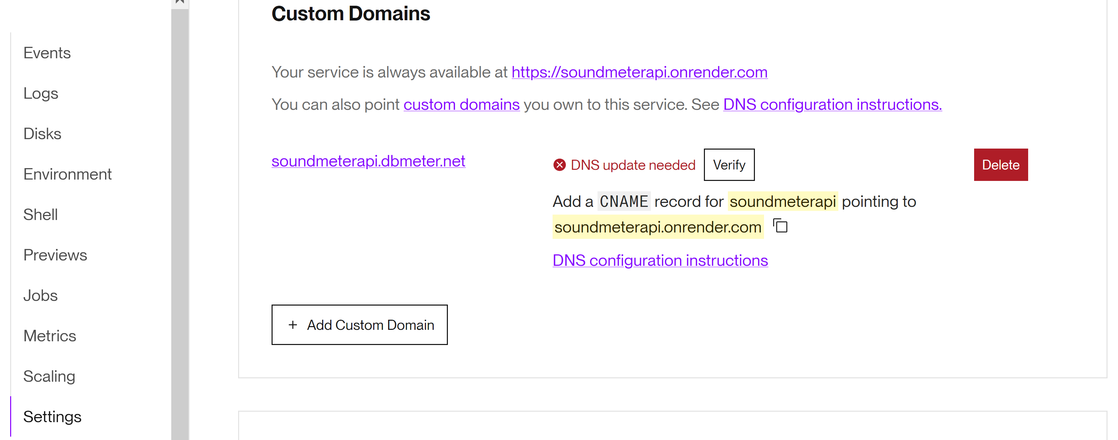
3. Verify Custom Domain

Slide 19
4. Open Web Service
https://soundmeterapi.dbmeter.net/api/categories
https://soundmeterapi.dbmeter.net/api/category/5

Slide 21
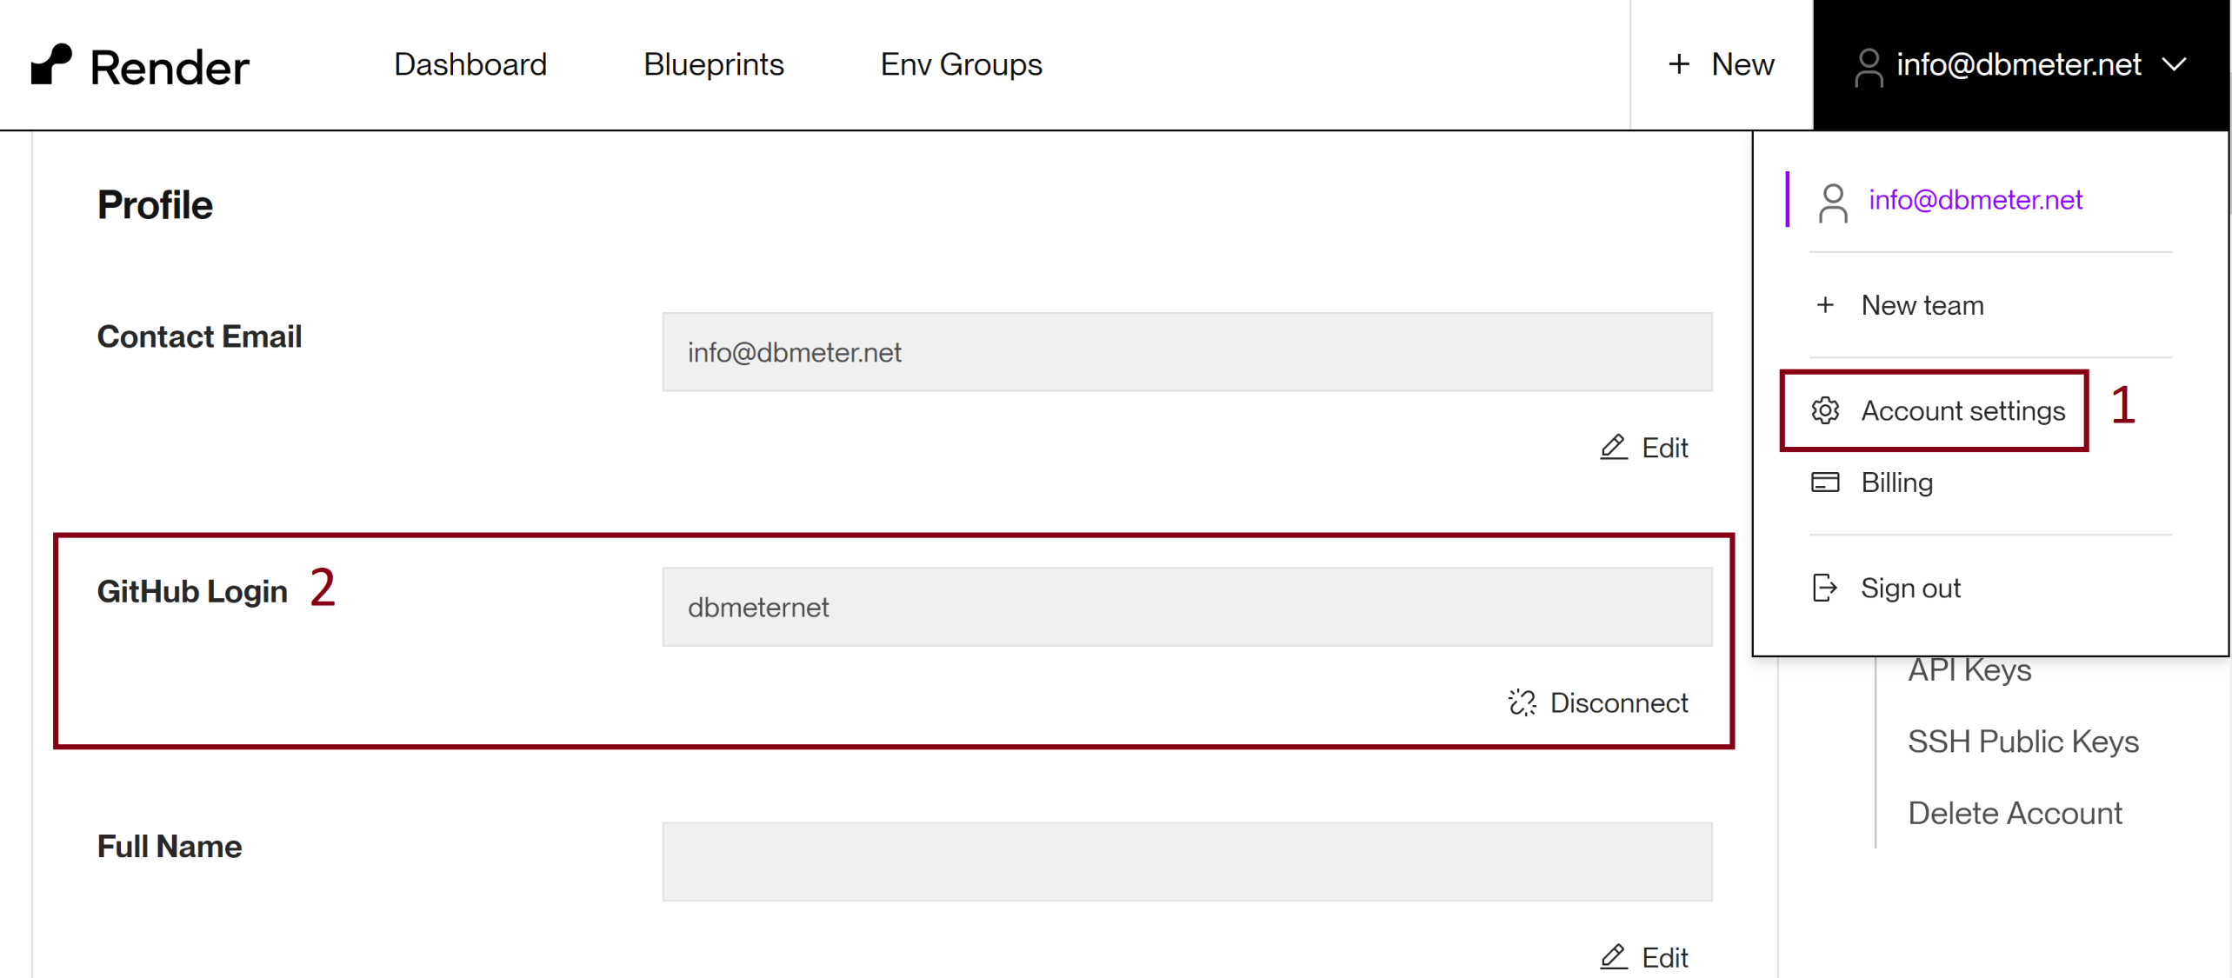
1. Update GitHub Login

Slide 23
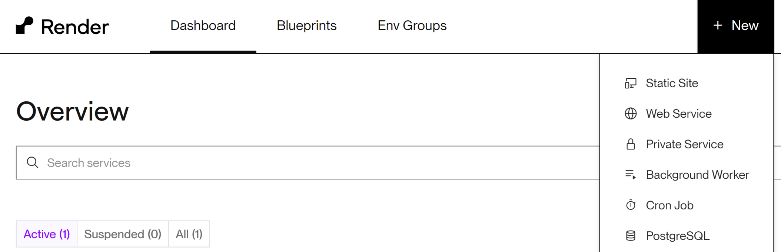
1. Create PostgreSQL

Slide 24
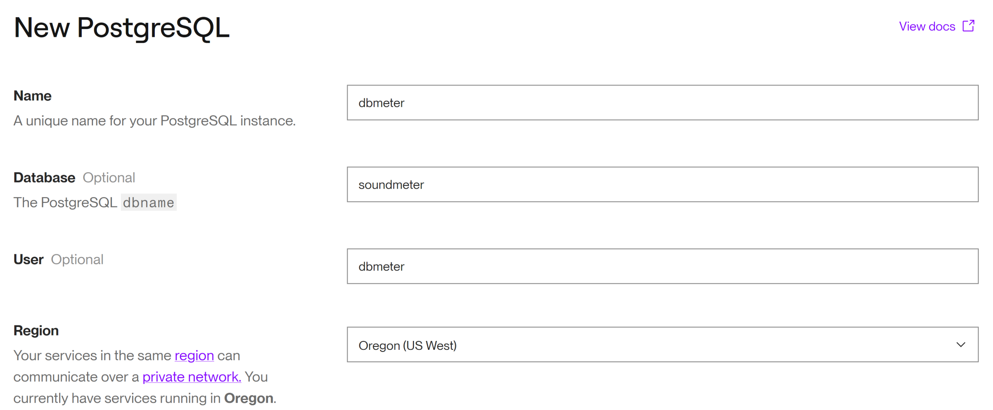
2. Enter Information
Your database will expire on August 12, 2024. The database will be deleted unless you upgrade to a paid instance type.

Slide 25

Thank You & See You Again

